Slide 1
WELCOME
Rob Hine - BSi

Slide 2
Copyright © 2016 BSI. All rights reserved.

Slide 3
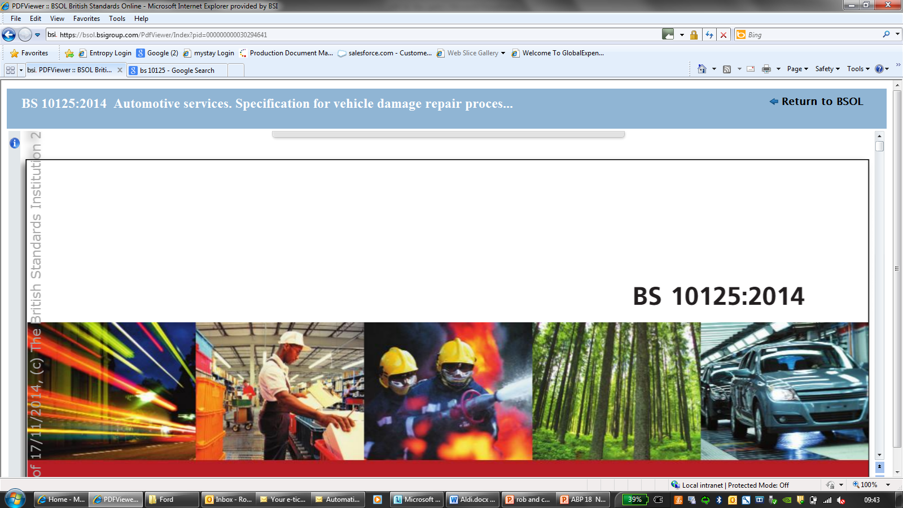
BS 10125: 2014 + A1: 2016
Notes:
Km based on standards
400+
PAS origins
Good standard

Slide 5
THANK YOU
Rob Hine - BSi

